Slide 1
Given At: ArchConf2019
Uberconf 2020

Slide 2
Avoiding Lock-In

Slide 3
Survey
Word Cloud

Slide 4
Previous
Version
Custom
Fork
Specific
Framework
Our own
code

Slide 5
Previous
Version
I’m on v.4.5 but I want to upgrade to the latest 8.9

Slide 6
Custom
Fork
We made a customization of hybris and now I can’t merge the latest fixes

Slide 7
Specific
Framework
I’m websphere but I want to be on micronaut

Slide 8
Our own
code
I hate the Core_Heat system. We should rewrite that.
Well, we built our own database in the 90’s and …

Slide 9
Previous
Version
Custom
Fork
Specific
Framework
Our own
code

Slide 10
Previous
Version
Custom
Fork
Previous
Version
Specific
Framework
Our own
code
I’m on v.4.5 but I want to upgrade to the latest 8.9

Slide 11
V3.01
v8.4.3

Slide 12
V3.01
v8.4.3

Slide 13
V3.01
v8.4.3

Slide 14

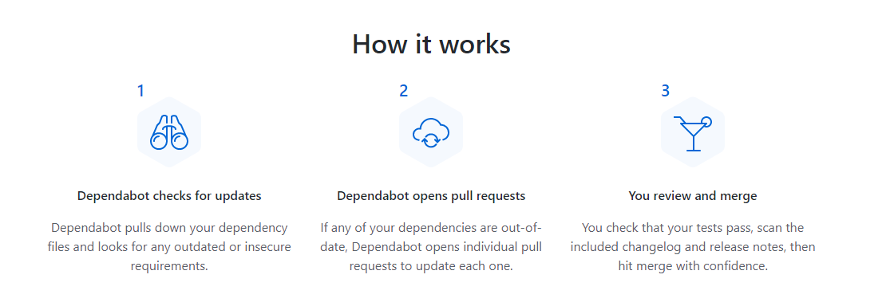
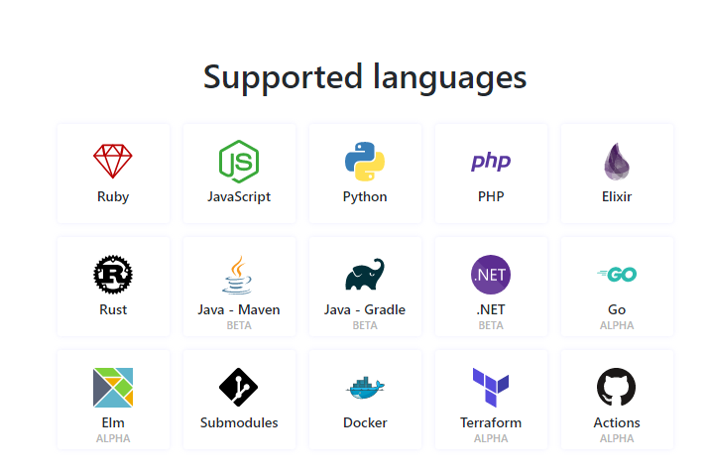

Slide 16
V3.01
v8.4.3

Slide 17

CI

Slide 18
Example at:
https://github.com/approvals/ApprovalTests.Java/commits/master?after=f006147d66edcd119a246b6d16e48744362cc1fa+34

Slide 19
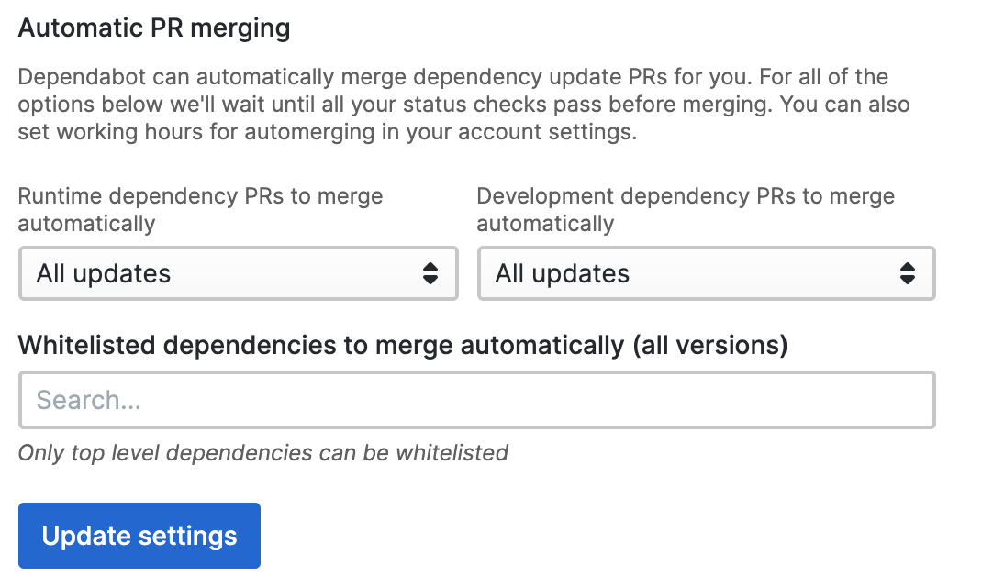

Slide 20
V3.01
v8.4.3

Slide 21
V3.01
v8.4.3

Slide 22
V3.01
v8.4.3

Slide 23
Discussion:
1) Have you had this problem? 2) How did you approach it? 3) Thoughts on recommendations? 4) Other ideas
Notes:
1) Have you had this problem? 2) How did you approach it? 3) Thoughts on recommendations? 4) Other ideas

Slide 24
PART I

Slide 25
Custom
Fork
Previous
Version
Custom
Fork
Specific
Framework
Our own
code
We made a customization of hybris and now I can’t merge the latest fixes

Slide 26
Jumping into trouble

Slide 27
git clone https://chromium.googlesource.com/chromium/src

Slide 28
FORK

Slide 29
6.7 million lines of code
150 are yours

Slide 30
0 ☛ Legacy

Slide 31
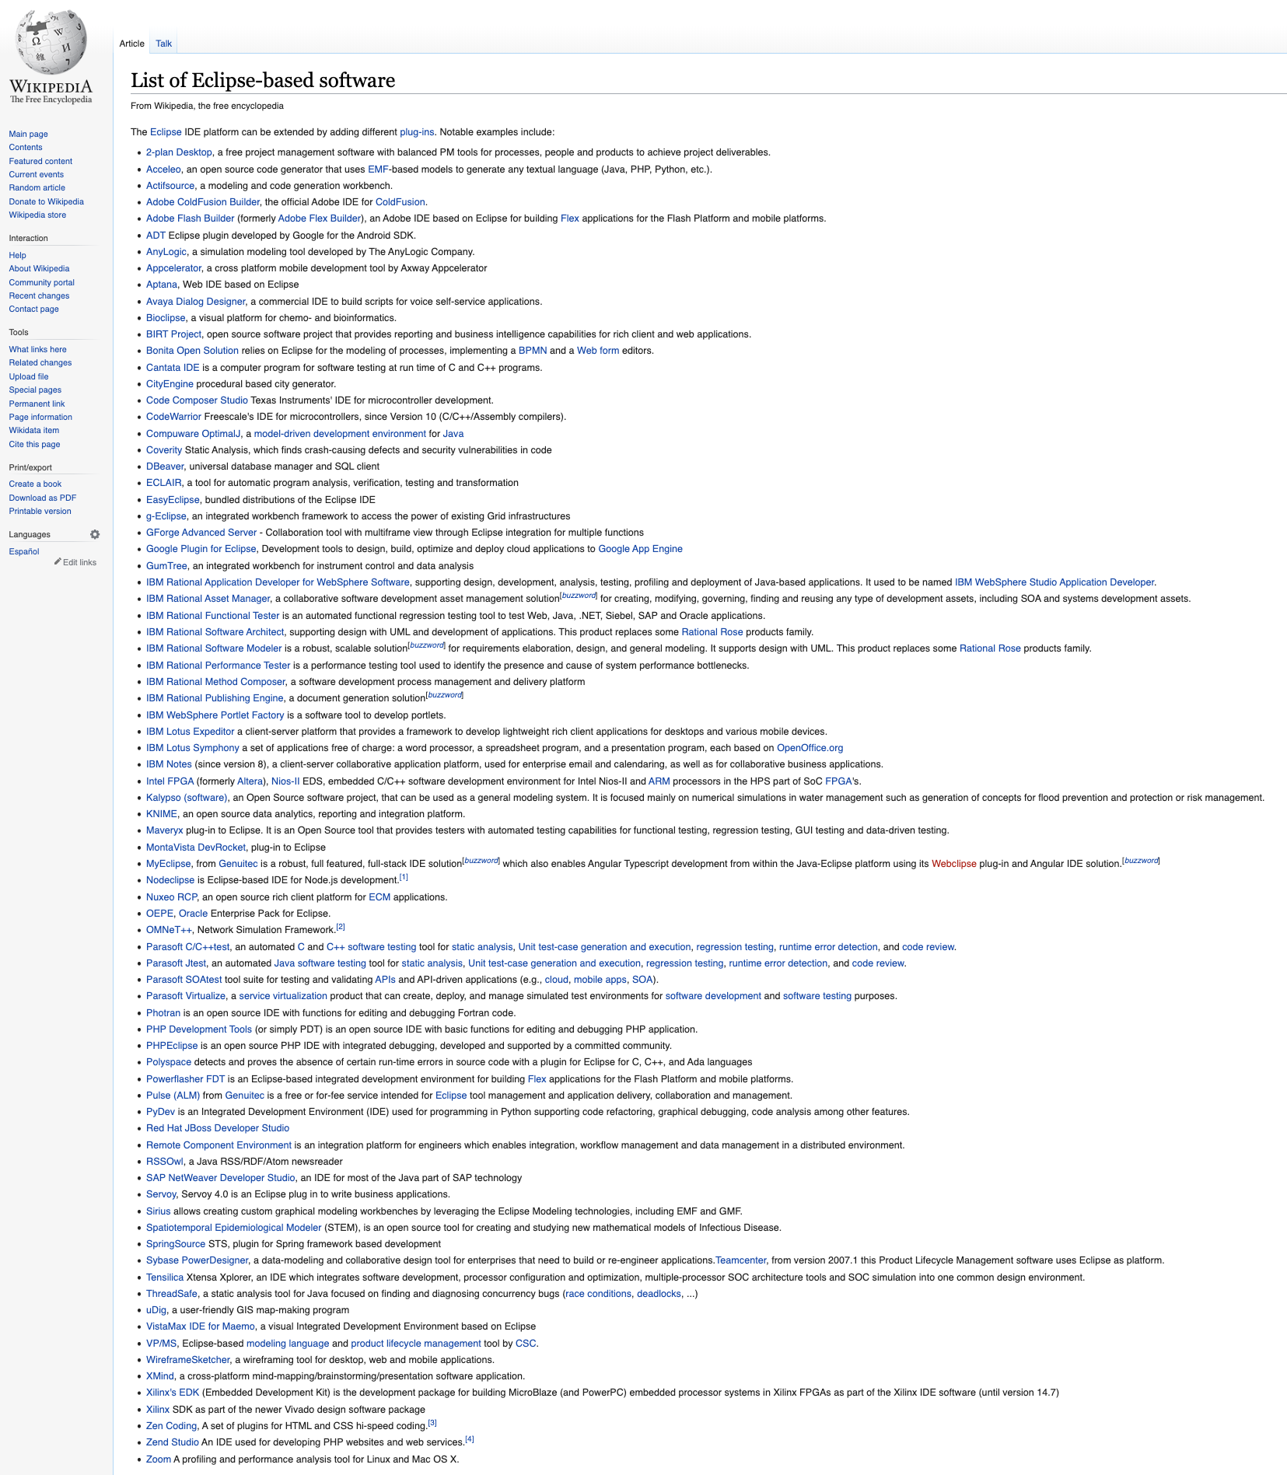


Slide 32
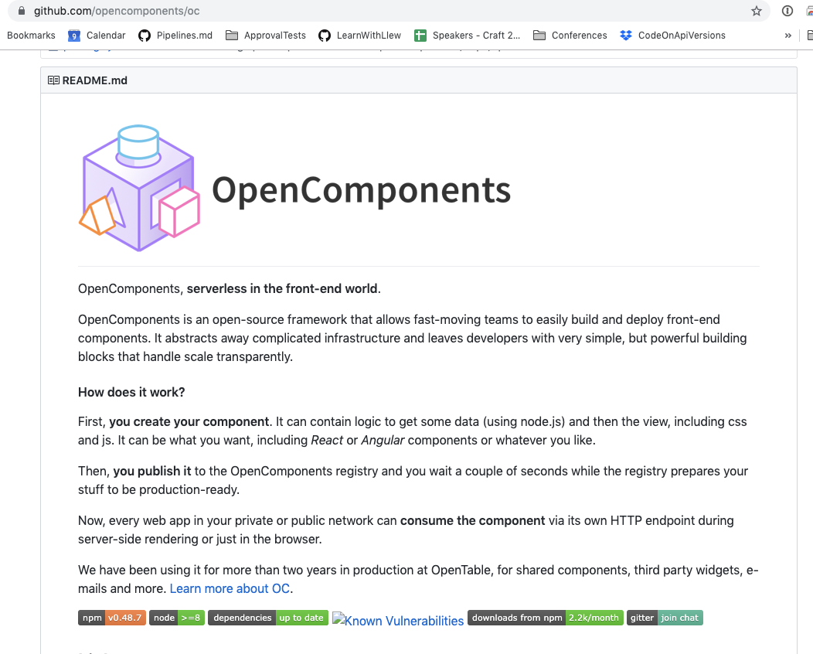


Ken Crawford
Notes:
Open components - aws -> google -> made it extendable -> became a maintainer -> met

Slide 33
Maintenance
Responsibilities
Create
Plug-In Point
Create plugin
Plugin Point accepted
Plugin
(or some subset)
is accepted
Nothing is accepted
Plug-In
Out of the box
Plug-In + Minimum Customization
~100 lines
~1000 lines

Slide 34
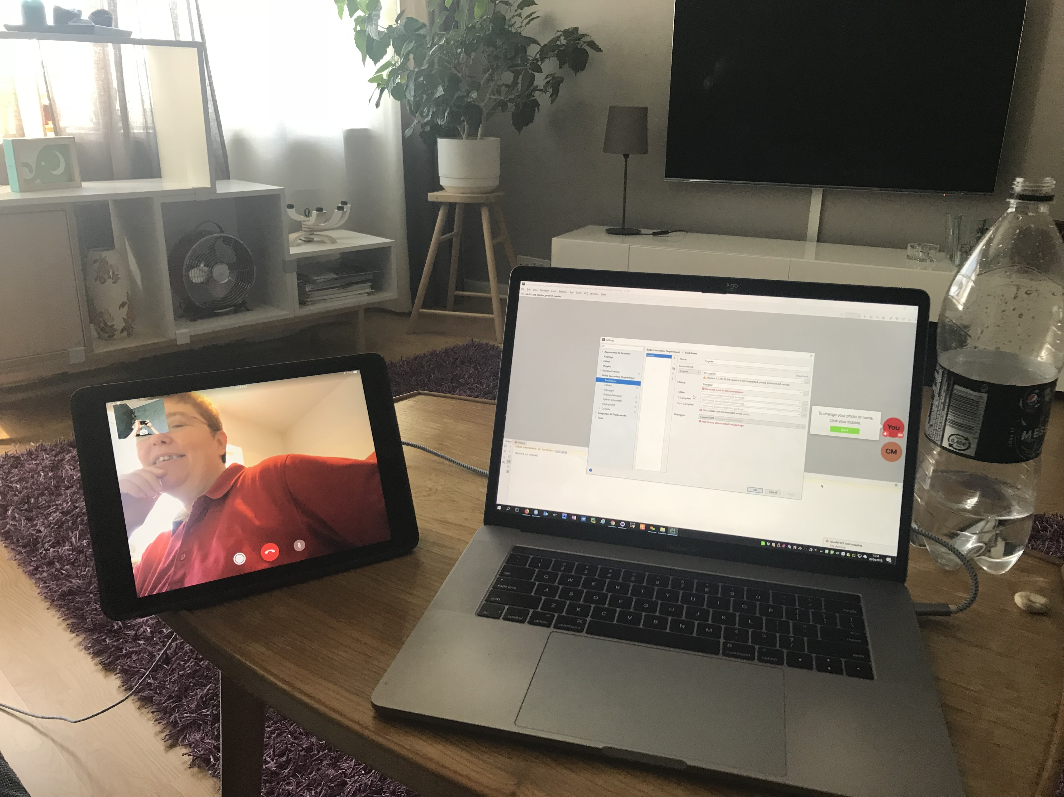
Tips
Pair
https://www.greaterthancode.com/pairing-and-sharing

Slide 35
Tips
Pay

Slide 36
Discussion:
1) Have you had this problem? 2) How did you approach it? 3) Thoughts on recommendations? 4) Other ideas
Notes:
1) Have you had this problem? 2) How did you approach it? 3) Thoughts on recommendations? 4) Other ideas

Slide 37
PART II

Slide 38
Specific
Framework
Previous
Version
Custom
Fork
Specific
Framework
Our own
code
I’m websphere but I want to be on micronaut

Slide 39
Framework
Business Logic
Services

Slide 40
Framework
“A Framework is anything that calls your business logic”

Slide 41
“A service is anything that your business logic calls”
Services

Slide 42
Framework
Business Logic
Services

Slide 43
Thin
Separation
Separation
Framework
Business Logic
Services

Slide 44
Framework
Business Logic
Services

Slide 45
public static void main(String[] args) throws Exception {
String inputPort = null;
String outputPort = null;
int i = 0;
LongOpt[] longopts = new LongOpt[6];
longopts[i++] = new LongOpt("output", LongOpt.REQUIRED_ARGUMENT, null, 'o');
longopts[i++] = new LongOpt("input", LongOpt.REQUIRED_ARGUMENT, null, 'i');
Getopt g = new Getopt("Qualm", args, "o:i:", longopts);
int c;
while ((c = g.getopt()) != -1) {
switch(c)
{
case 'i':
inputPort = g.getOptarg();
break;
case 'o':
outputPort = g.getOptarg();
break;
}
}
if (g.getOptind() == args.length) {
System.out.println("No filename given.");
System.exit(0);
}
String inputFilename = args[g.getOptind()];
QData data = new QDataLoader().load(inputFilename);
// Set up MIDI ports
Properties props = new Properties();
props.setProperty("inputPort", inputPort);
props.setProperty("outputPort", outputPort);
midiOut = new JavaMidiReceiverFactory().buildFromProperties(props);
midiIn = midiOut;
loopThroughPatches(data);
System.exit(0);
}
Framework
Business Logic

Slide 46
public static void main(String[] args) throws Exception {
int i = 0;
LongOpt[] longopts = new LongOpt[6];
longopts[i++] = new LongOpt("output", LongOpt.REQUIRED_ARGUMENT, null, 'o');
longopts[i++] = new LongOpt("input", LongOpt.REQUIRED_ARGUMENT, null, 'i');
Getopt g = new Getopt("Qualm", args, "o:i:", longopts);
new PlayAllPatches().start(g);
}
public void start(Getopt g){
String inputPort = null;
String outputPort = null;
int c;
while ((c = g.getopt()) != -1) {
switch(c)
{
case 'i':
inputPort = g.getOptarg();
break;
case 'o':
outputPort = g.getOptarg();
break;
}
}
if (g.getOptind() == args.length) {
System.out.println("No filename given.");
System.exit(0);
}
String inputFilename = args[g.getOptind()];
QData data = new QDataLoader().load(inputFilename);
// Set up MIDI ports
Properties props = new Properties();
props.setProperty("inputPort", inputPort);
props.setProperty("outputPort", outputPort);
midiOut = new JavaMidiReceiverFactory().buildFromProperties(props);
midiIn = midiOut;
loopThroughPatches(data);
System.exit(0);
}
Framework
Business Logic

Slide 47
public static void main(String[] args) throws Exception {
new PlayAllPatches().start(loadOption(args));
}
Framework
Business Logic

Slide 48
1) Parameter extraction 2) Call Business Logic 3) Marshall Results
Framework

Slide 49
Loader & Saver
Services

Slide 50
POJO

Slide 51
Spring dependency Injection

Slide 52
Discussion:
1) Have you had this problem? 2) How did you approach it? 3) Thoughts on recommendations? 4) Other ideas
Notes:
1) Have you had this problem? 2) How did you approach it? 3) Thoughts on recommendations? 4) Other ideas

Slide 53
Previous
Version
Custom
Fork
Our own
code
Specific
Framework
Our own
code
I hate the Core_Heat system. We should rewrite that.
Well, we built our own database in the 90’s and …

Slide 54
Our own
code
I hate the Core_Heat system. We should rewrite that.
Well, we built our own database in the 90’s and …

Slide 55
Business Logic
Services

Slide 56
Business Logic
Custom non-core business helpers

Slide 57
Our own
code
I hate the Core_Heat system. We should rewrite that.
Well, we built our own database in the 90’s and …

Slide 58

Thanks!
Please connect on
LinkedIn & Twitter
@LlewellynFalco
llewellynfalco.blogspot.com
Presentation template by SlidesCarnival

Slide 59
SlidesCarnival icons are editable shapes.
This means that you can:
Resize them without losing quality.
Change line color, width and style.
Isn’t that nice? :)
Examples:

